Slide 1
Microeconomics
^{COST FUNCTIONS}

Slide 2
Cost
Cost is defined as the expenditure incurred by a firm or producer to purchase or hire factors of production in order to produce a product.
The entrepreneur utilizes land, labour, capital and raw materials to produce output.
Is the producer be compensated for his/her services?

Slide 3
Elements of cost:
Wages, rent, interest, profit are called factor costs of production.
Besides these, the producer also incurs expenditure on raw materials, electricity, water, depreciation of capital goods such as machines and indirect taxes etc.
The producer also uses the services of certain factors supplied by his/her own self. The imputed value of such inputs also form the part of cost.

Slide 4
Types of costs: Explicit cost
A firm purchases assets like building, machine etc. It pays rent for building, it employs workers, accountant manager etc. and pays wages and salaries to them.
It borrows money and pays interest on it.
It purchases raw material, pays electricity bills and makes such other payments.
All such actual payments, on purchasing and hiring different goods and services used in production are called ‘explicit costs’.

Slide 5
Types of costs: Implicit cost
All inputs are not always bought or hired by the producer from the market. Some of the inputs are provided by the entrepreneur or producer himself.
He may use his own building. He may invest his own money in the business.
He may be the manager of his own firm. A farmer may cultivate his own land. These are called Imputed costs.
Such cost is the imputed rent for the self owned factory building.

Slide 6
Opportunity cost
The value of next best alternative foregone.
A farmer can produce either rice or wheat on a piece of land. If he has decided to produce wheat on this piece of land, he has to forego the production of rice.
The value of rice foregone (next best alternative) is the opportunity cost of producing wheat.

Slide 7
Normal Profit
The Minimum surplus or profits that a producer should get in order to produce a commodity.
He must be able to get normal profit in addition to recovering his ‘explicit cost’ and ‘implicit cost’.

Slide 8
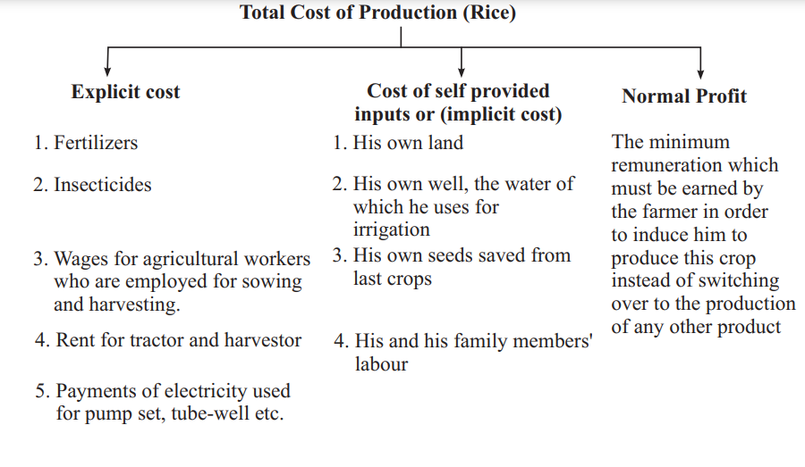
Total Cost of Production

